Slide 2

XAFS fundamentals, data reduction and analysis
Vera Cuartero
BM23 (ESRF)
cuartero@esrf.fr
hν
R_{j}

Slide 3
XAFS fundamentals, data reduction and analysis
Fundamentals of X-ray Absorption Fine Structure (XAFS)
Measurement of Cu foil at BM23
Data analysis Cu foil
Real sample preparation, CuO
Data analysis, comparison
hν
R_{j}

Slide 4
Interaction of x-rays with matter (e< 1 MeV)
X-ray
fluorescence
Auger electrons
E_{A}
Photo-electric
Absorption
hν_{F}
Photo-electrons
E
hν
X-ray Beam
attenuation
Incoming x-ray beam
(monochromatic)
hν
Scattering
hν′
Elastic scattering
(Thomson)
Inelastic scattering
(Compton)

Slide 5
Atomic cross section (e< 1 MeV)
Quantifies the strength of the X-ray – matter interaction
For photon energies between 1 and 30 keV the photoelectric absorption is the leading interaction with matter
μ/ρ = (N_{A}/A)σ_{a}
σ_{a}= σ_{pe} + σ_{coh} + σ_{incoh} + σ_{pp}

Slide 6




X-ray absorption process: the simple picture
E-E₀
Synchrotron
light
Energy
E
E₀
Nobel Prize 1921
(1) An incident x-ray of energy E is absorbed, destroying a core electron of binding energy E₀
and (2) emitting a photo-electron with kinetic energy (E-E₀), to some unoccupied state.
(3) The core state is eventually filled (1 or 2 fs later), ejecting a fluorescent x-ray or an Auger electron.

Slide 7
X-ray absorption process: photoelectric effect
Hard X-rays (light with energy 1 ≤ E ≤ 100 keV or wavelength 0.12 ≤ λ ≤ 12 Å) are absorbed by all matter through the photoelectric-effect:
When the incident x-ray has an energy equal or greater than the binding energy of a core-level electron (K=1s; L_{I}=2s; L_{II}, L_{III}=2p, etc.), the x-ray photon is absorbed and the core electron is ejected from the atom.
The atom is left in an excited state with an empty electronic level (core hole) and any excess energy is given to the ejected photo-electron.
Nobel Prize 1921
The excited core-hole will relax back to the “ground state” of the atom by two main mechanisms: X-ray Fluorescence, for hard x-ray regime (> 2 keV) and Auger Effect for lower energy x-ray absorption.

Slide 8
DE-EXCITACTION PROCESSES
When x-rays are absorbed by the photoelectric effect, the excited core-hole
will relax back to a “ground state” of the atom. A higher level core electron
drops into the core hole, and a fluorescent x-ray or Auger electron is emitted.
X-ray Fluorescence:
A higher energy core-level electron fills the deeper core-hole, ejecting an x-ray of energy equal to the difference of the core-levels.
Auger Effect:
A higher energy core-level electron drops into the core-hole and a second electron is emitted into the continuum from another core-level.
Continuum
Continuum
X-ray fluorescence and Auger emission occur at discrete energies that are characteristic of the absorbing atom.

Slide 9
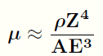
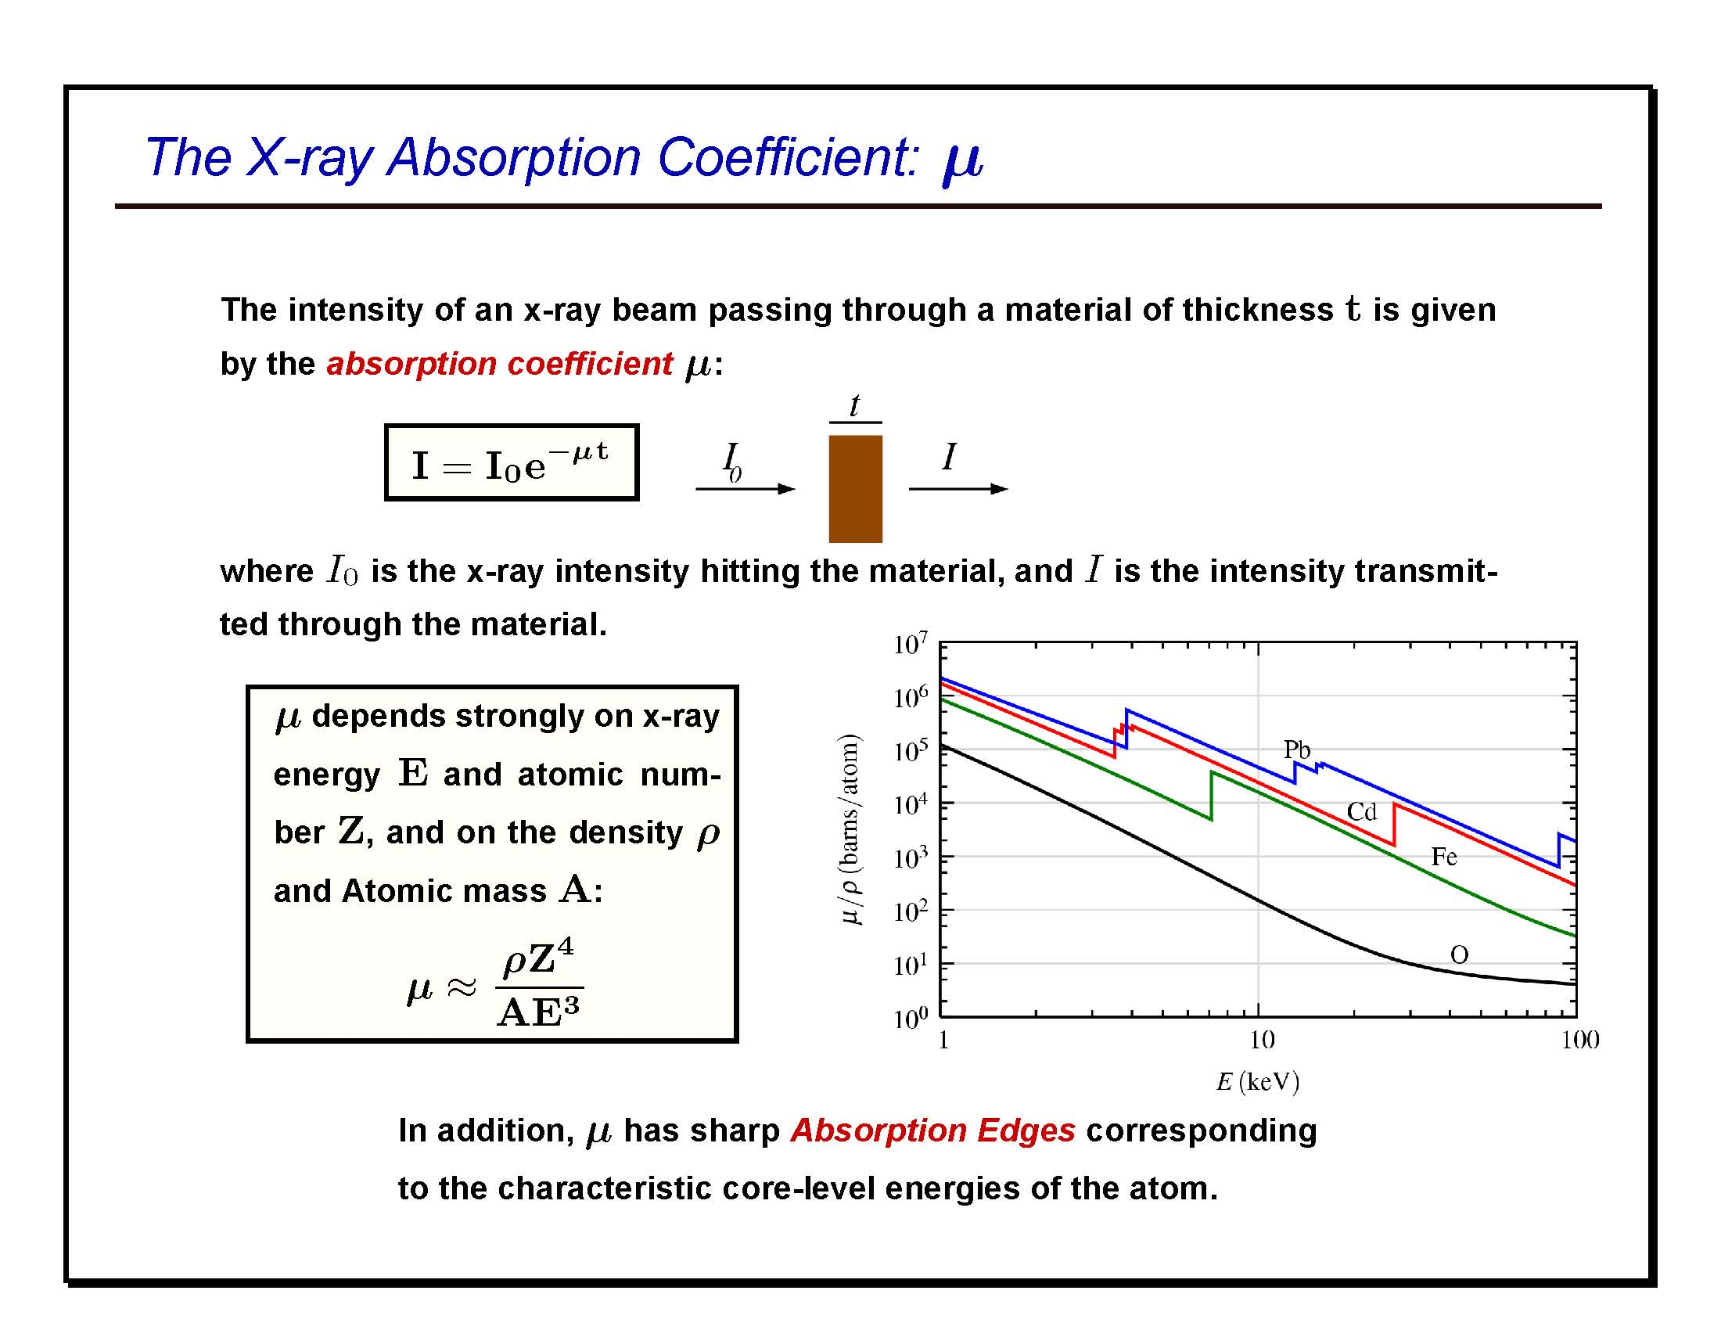
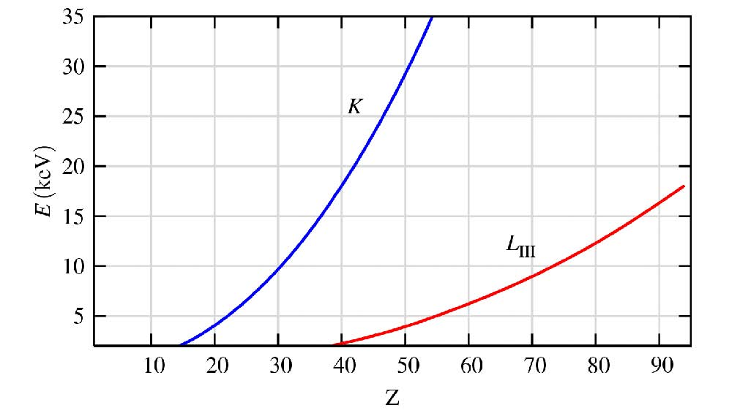
THE ABSORPTION COEFFICIENT μ
The probability that an x-ray beam passing through a material of thickness t will be absorbed is given by the linear absorption coefficient, μ:
Good contrast
μ(E) ∝ Z⁴ / E³
Element specific
E_{K} ∝ Z²

Slide 10
X-ray absorption measurement
XAFS measures the energy dependence of μ(E) near and above the absorption edge of a selected element.
synchrotron
source
transmitted flux
monitor
monochromator
incident flux
monitor
t
I₀
sample
I
polychromatic
X-rays
monochromatic
X-rays
Transmission:
The absorption is measured directly by measuring what is transmitted through the sample:
I = I₀ e^{−μ (E)t}
μ(E) t = − ln (I/I₀) Beer-Lambert Law
Fluorescence:
The re-filling the deep core hole is detected. Typically the fluorescent x-ray is measured.
μ(E) ~ I_{F}/I₀

Slide 11

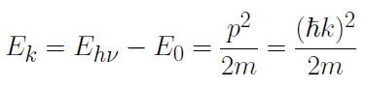
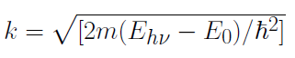
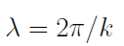
Xafs: simple physical description
Isolated “bare” atom
X-ray photon with enough energy ejects one core (photo)electron (photoelectric effect)
The photoelectron can be described by a wave function approximated by a spherical wave
Kinetic energy
of the p.e.
wavevector of the p.e.
wavelength of the p.e.
λ ~ 1/(E-E₀)^{1/2}
E

Slide 12
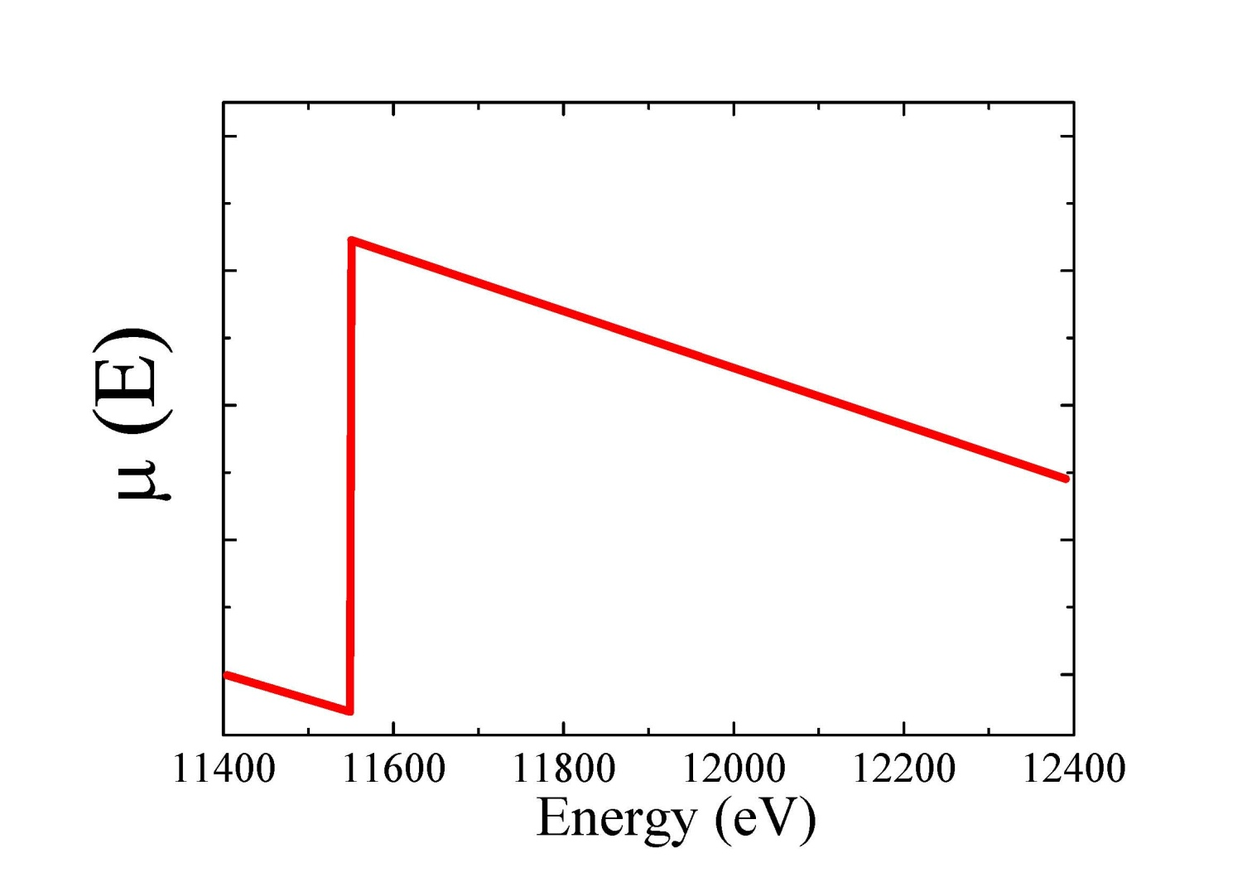
Xafs: simple physical description
Isolated “bare” atom
The atom absorbs an x-ray of energy E, destroying a core-electron of energy E₀ and creating a photo-electron with energy (E-E₀).
μ (E) has a sharp step at the core-level binding energy E₀ and is a smooth function of energy above this absorption edge.

Slide 13
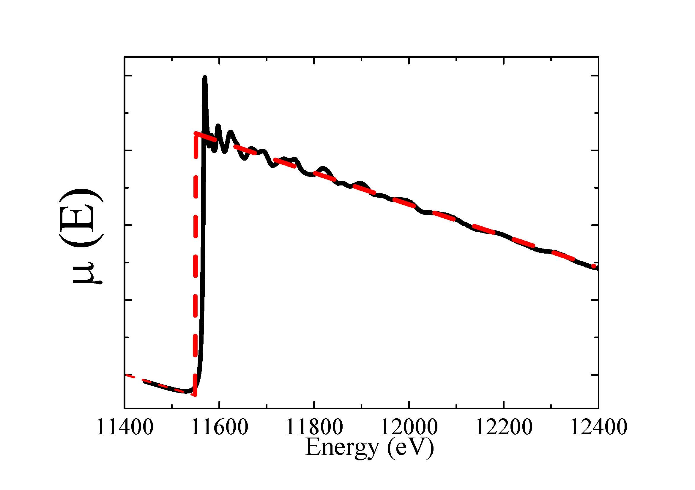
Xafs: simple physical description
Condensed Matter
Extended X ray Absorption Fine Structure
EXAFS OSCILLATIONS
The probability of absorption oscillates!
Proximity of neighboring atoms strongly modulates the absorption coefficient

Slide 14

eXafs qualitatively: condensed matter
Diatomic molecule
The photoelectron can scatter from a neighbouring atom giving rise to an incoming spherical wave coming back to the absorbing atom
The outgoing and ingoing waves may interfere.
The ejected photo-electron propagates, can scatter from a neighbouring atom and returns to the absorbing atom.
Interference between out-going and back-scattered photo-electron waves at the core site give rises to modulation of the absorption coefficient.

Slide 15
Xafs: simple physical description
Diatomic molecule
E=hν
S
E₂
“ destructive “
E₁
“ constructive “
A
The ejected photo-electron propagates, can scatter from a neighbouring atom and returns to the absorbing atom.
Interference between out-going and back-scattered photo-electron waves at the core site give rises to modulation of the absorption coefficient.

Slide 16
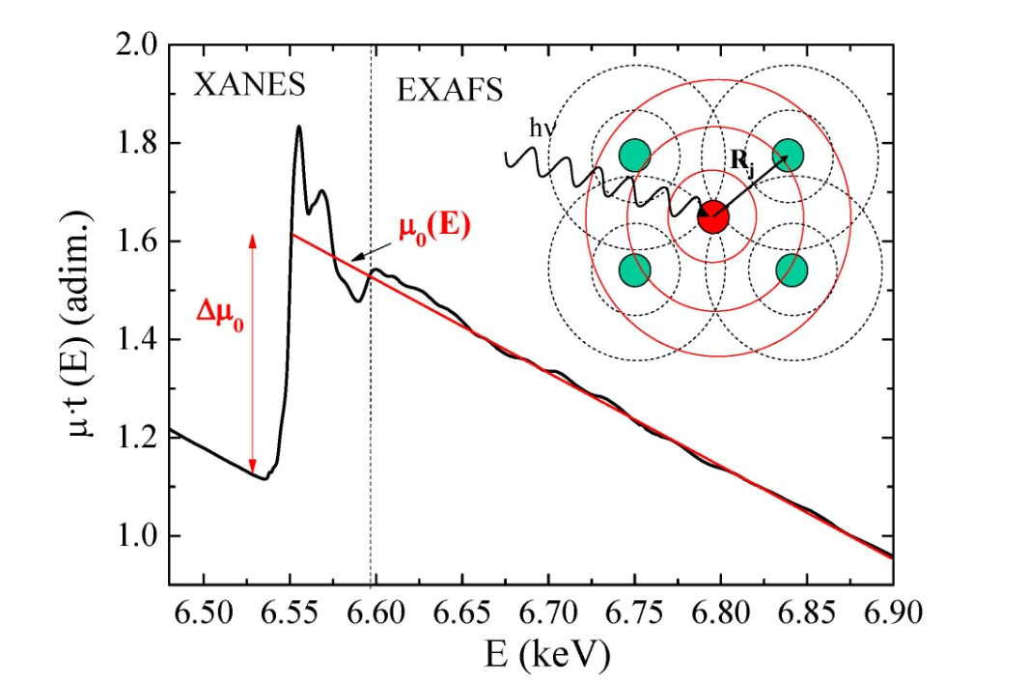
Exafs definition
What? Oscillatory behaviour of the of the X-ray absorption as a function
of photon energy beyond an absorption edge
When? Non isolated atoms
Why? Proximity of neighboring atoms strongly modulates the absorption coefficient
The EXAFS oscillations are an interference effect of the photo-electron with itself, due to the presence of neighboring atoms.
EXAFS oscillations:
μ₀(E) smooth “bare atom” background
Δμ₀(E₀) edge step or jump

Slide 17
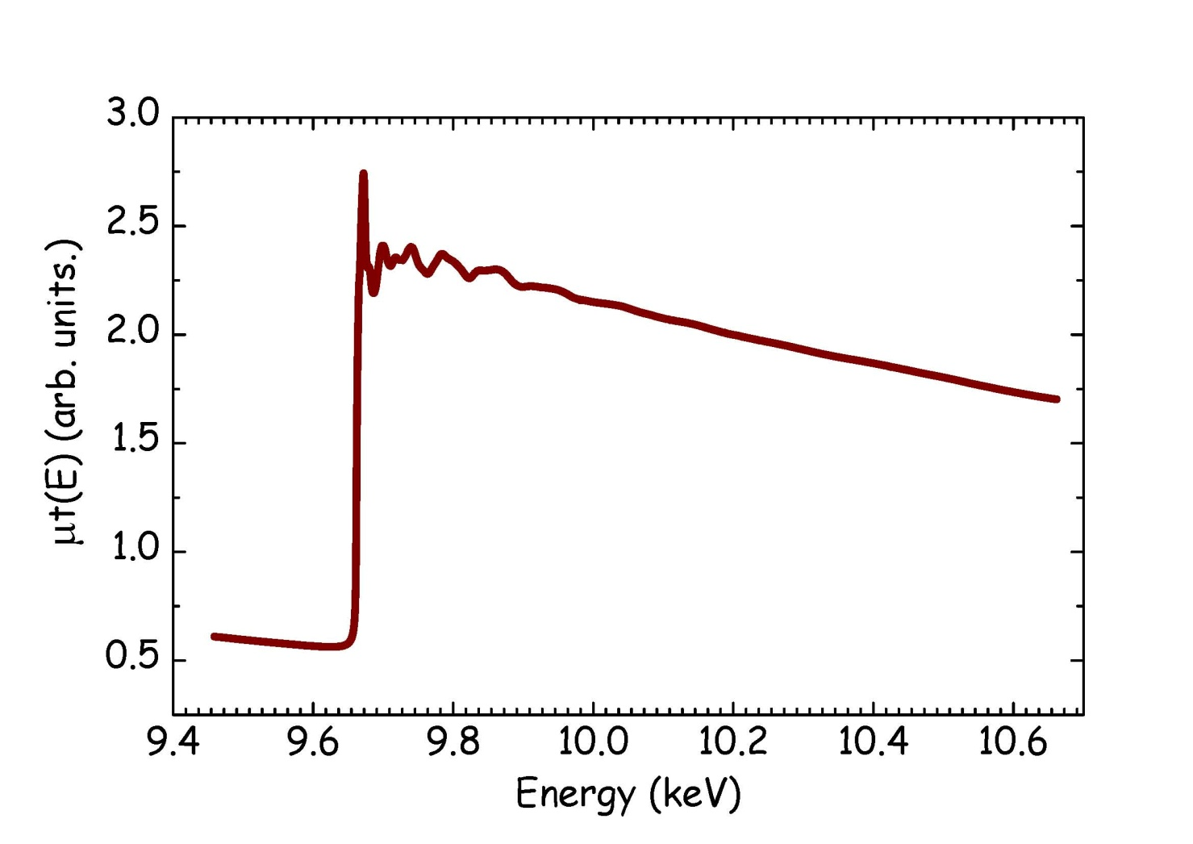
XAFS NOMENCLATURE: XANES AND EXAFS
XANES
EXAFS
X-ray
Absorption
Near
Edge
Structure
Extended
X-ray
Absorption
Fine
Structure
from ~ 80 eV
to 1200 eV
above the edge
up to ~ 60 eV
above the edge

Slide 18
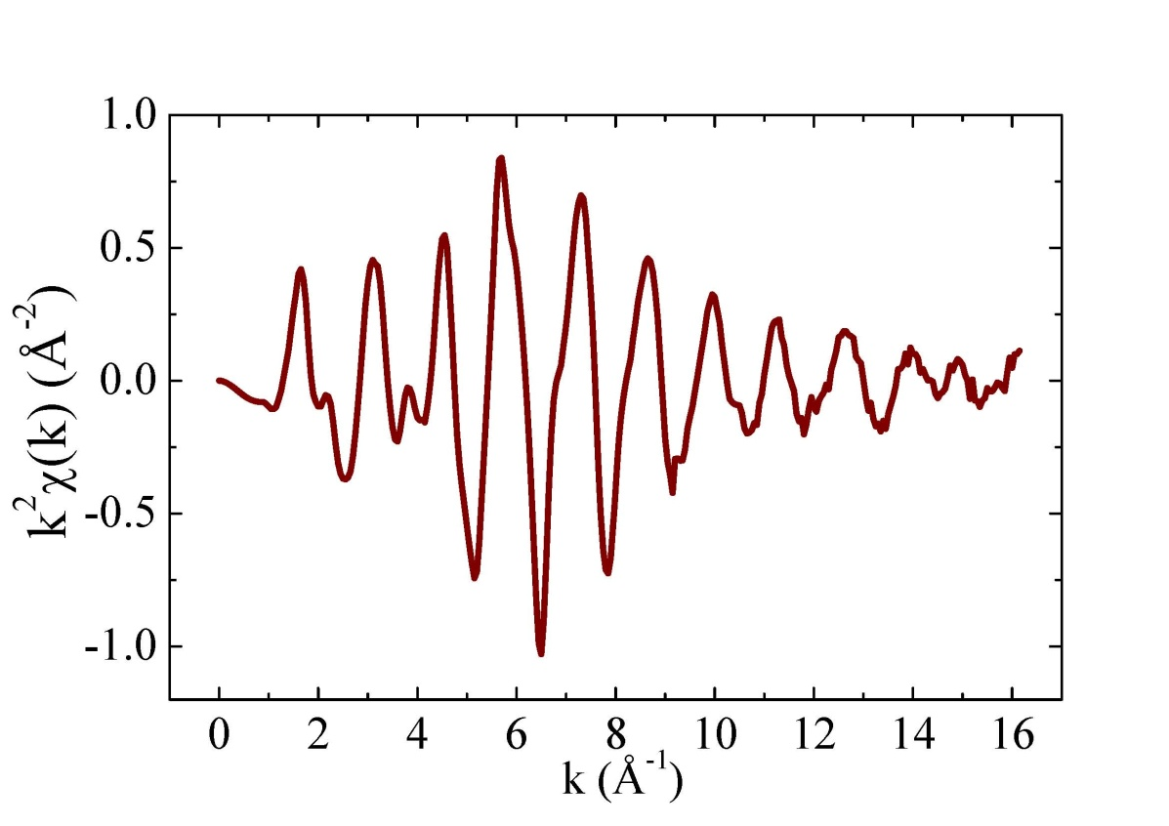
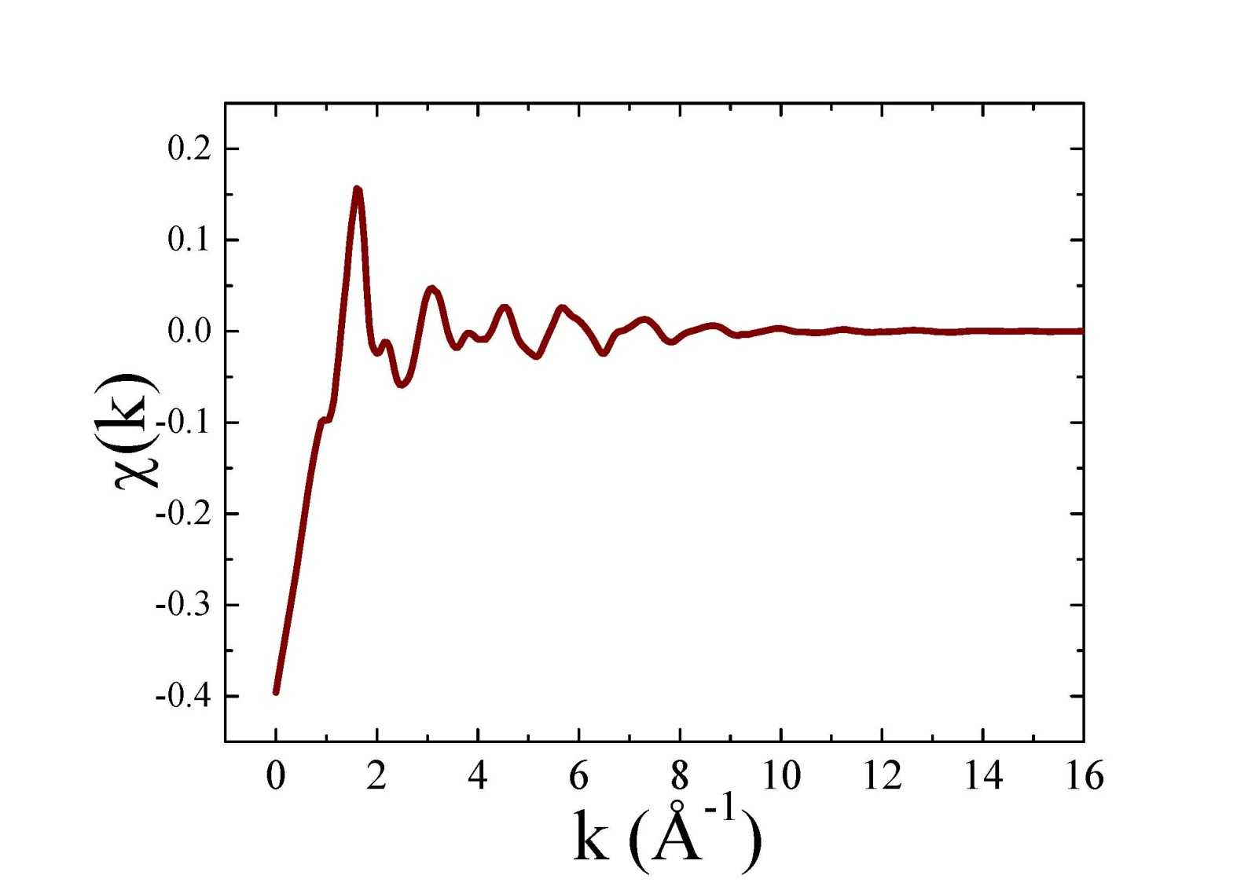
Exafs oscillations, χ(k)
EXAFS depends on the wave nature of the photo-electron
Photon (E)
k² or k³ weighted
↓
Oscillations at high-k
Photo-electron (k)

Slide 19
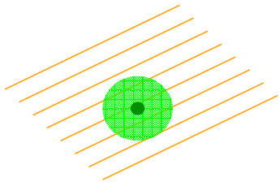
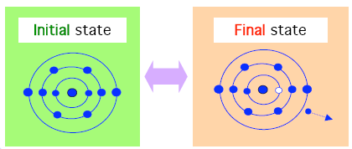
Exafs: physical description
Fermi´s Golden Rule describes μ(ω) as a transition between two quantum states :
Energy conservation
Transition probability
Approximations!
Weak interaction
Electric dipole H
One-electron
1st order perturbation
1 core electron excited
N-1 passive electron relaxed
Initial state: core-electron
(x-ray photon)
Final state: photo-electron
(core hole)
x-ray polarization electron position
photoelectron ≠ passive e⁻
Page 19

Slide 20
Exafs: physical description
Fermi Golden Rule
1 active electron
Dipole interaction
N-1 electrons
relaxation
Structural information
Wave-function
of the scattered photo-electron
at the absorbing atom
The region where ψ _{i} ≠ 0 represents simultaneously the source and the detector for the photoelectron that probes the local structure around the absorber atom
Page 20

Slide 21
Exafs: physical description
We can build a simple model for χ from the photo-electron for a two-atomic system:
1. Leaving from the absorbing atom
2. Scattering from the neighbour atom
3. Returning to the absorbing atom
The outgoing photo-electron wave-function →
Spherical wave: + a neighbour atom at a distance R
Back & forth
path
Spherical wave
attenuation
Back-scattering amplitude phase-shift → “Neighbour atom”
Page 21

Slide 22
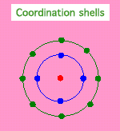
The exafs equation: many atomic system
Single and multiple scattering paths
Multiple-scattering
paths are most
important when the
scattering angle is
> 150 º
R₁
R₂
Thermal and static mean-square disorder in R
Amplitude reduction
term
Photo-electron mean-free path
(including core-hole lifetime)
Intrinsic losses on the EXAFS spectrum
Page 22
Notes:
Intrinsic looses which have to do with the formation of the core hole, and thus did not depend strongly on path length. In practice, S02 is very sensitive to measurement and data reduction issues such as harmonics, self-absorption, sample inhomogeneity, detector non-linearity, and incorrect normalization

Slide 23
Development of the EXAFS equation
For N scattering atoms, and with a thermal and static disorder of σ², giving the
mean square disorder in R*, we have
A real system will have neighboring atoms at different distances and of different
types. We add all these contributions to get a version of the EXAFS equation:
To obtain this formula we used a spherical wave for the photoelectron:
* EXAFS takes place on a time scale much shorter than that of atomic motion, so the measurement serves as an instantaneous snapshot of the atomic configuration

Slide 24
S₀² : Amplitude Reduction Term
Another important Amplitude Reduction Term is due to the relaxation of all the
other electrons in the absorbing atom to the hole in the core levels:
where Y_{f}^{N-1} accounts for the relaxation of the other N-1 electrons relative to
these electrons in the unexcited atom: Y₀^{N-1} . Typically S₀² is taken as a constant:
0.7 < S₀² < 1.0
which is found for a given central atom, and simply multiplies the XAFS c.
Note that S₀² is completely correlated with N.
This, and other experimental and theoretical issues, make EXAFS amplitudes (and therefore N) less precise than EXAFS phases (and therefore R).
Usually S₀² is found from a “standard” (data from a sample with well-known structure) and applied to a set of unknowns as a scale factor.

Slide 25
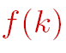
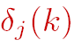
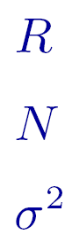
The exafs equation parameters
Parameters we need to calculate
scattering
amplitude
scattering properties of the atoms
neighboring the photoabsorber (depend
on the atomic number)
phase-shift
Parameters to fit
Distance to the neighbouring atom
Coordination number of the neighbouring atom
Disorder in the neighbour distance
Page 25

Slide 26
The exafs equation parameters
Distance to the neighbouring atom.
Or half path length, is the average distance between the absorbing and scattering atoms (single scattering path).
Coordination number of the neighbouring atom.
Or degeneracy of the path, is the identical number of distinct ways, per absorbing atom, that the scattering defined by the path can take place.
Disorder in the neighbour distance.
Or Mean Square Relative Displacement is the variance in the half path length, that is, the square of the standard deviation of the half path length: σ²=<(r-r_{m})²>.
Static and/or thermal disorder.
EXAFS takes place on a time scale much shorter than that of atomic motion, so the measurement serves as an instantaneous snapshot of the atomic configuration
Page 26

Slide 27
Exafs: a structural probe
If we know the scattering properties of the neighbouring atoms: f (k) and δ (k), and the mean-free
path λ (k), we can determine:
Frequency
Damping
Amplitude
Interatomic
distance
R
Debye-Waller
factor σ²
(disorder)
Coordinaction
number
N
The larger R, the smaller the spacing
Increasing MSRD decreases the amplitude
The amplitude of the path scales
with the degeneracy.
Page 27

Slide 28
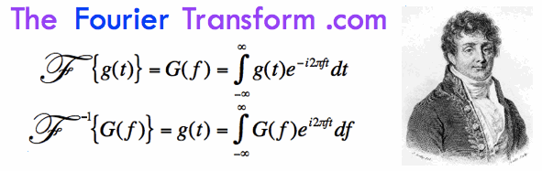
Exafs: a structural probe
Multiple terms in the EXAFS equation may be significant, each of them being a modulated sinusoid → need to decompose a function into constituent sine waves
Fourier transformation can be used to descompose a frequency-space signal into its different constituent frequencies. The Fourier transform of an EXAFS spectrum gives a pseudo-radial distribution function.
MnFe₂O₄
Fe K edge
Fe-O = 2.005 Å
Fe-Fe = 3.005 Å
EXAFS signal
Fe-Mn = 3.523 Å
Fourier Transform Magnitude (·k)
k (Å⁻¹)
R (Å)
FT distances are shifted by
~ -0.5 Å
Page 28

Slide 29
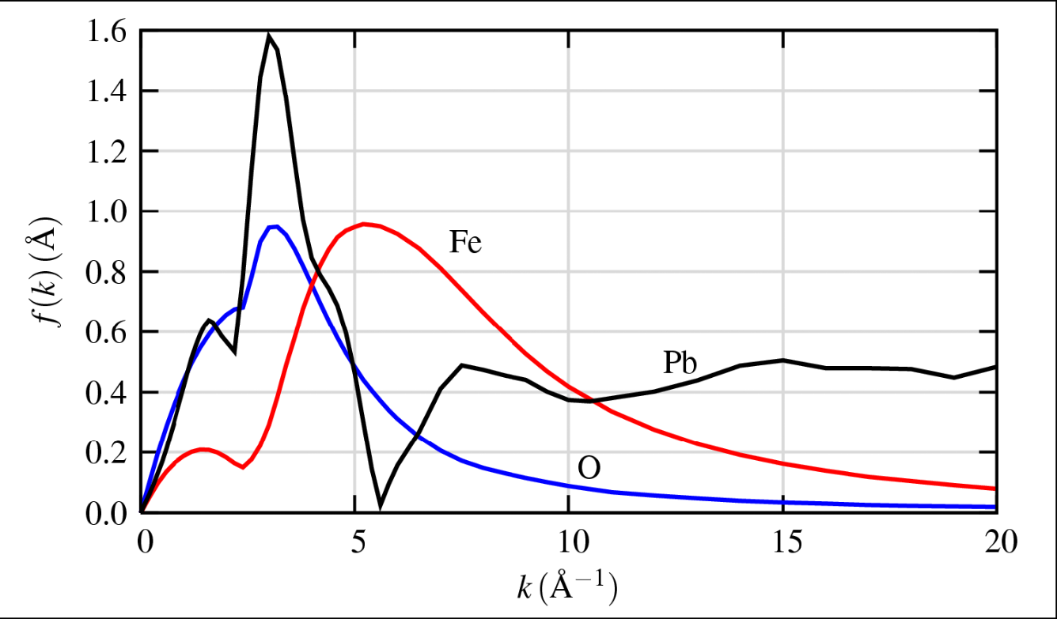
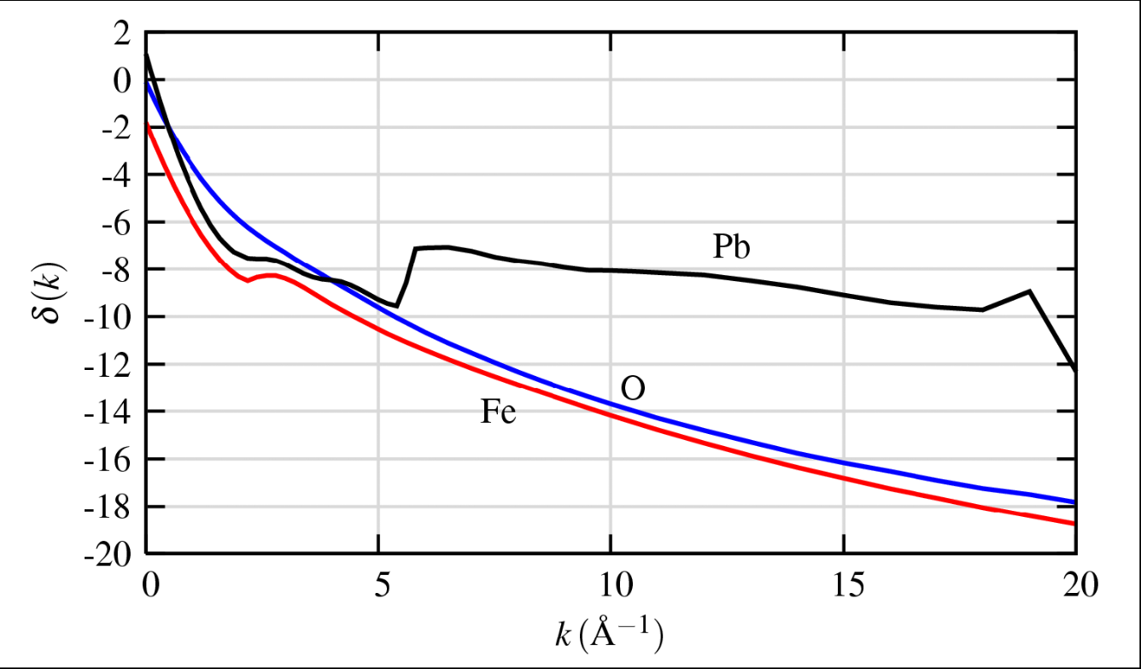
Exafs: selectivity of atomic species
The scattering amplitude f (k) and phase shift δ (k) depend on the atomic number Z
The scattering amplitude f (k) peaks at different k values and extends to higher-k for heavier elements. For very heavy elements, there is structure in f (k).
The phase shift δ(k) shows sharp
changes for very heavy elements.
These scattering functions can be
accurately calculated (say with the
programs FEFF, GNXAS, etc.), and used in the EXAFS modeling.

Slide 30
Exafs: a short range order probe
The photo-electron mean-free path λ (k) limites how far the photo-electron can go:
Inelastic scattering
Core-hole finite life-time
The mean-free path λ depends on k
λ < 25 Å for the EXAFS k-range
The term makes EXAFS a local atomic probe,
typically within 10 Å from the absorber
Page 30

Slide 31
Exafs accuracy
Distances ±0.01Å The absorber–scatter distance can be
measured quite accurately from the frequency
of the sinusoidal oscillations.
Coordination numbers
Debye-Waller factors ± 20-25% High correlation between them ↔ less accurate
Scattering Atom Z ± 1 (Z=6-17)
Z ± 3 (Z=20-35)
Elements that are next to each other in the periodic
table has barely distinguishable photoelectron scattering
characteristics. Thus, C,N and O are impossible to
distinguish and metal scattered can only be placed
in the proper row of the periodic table
Page 31

Slide 32
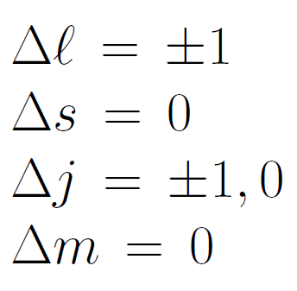
Xanes region
What is XANES ?
XANES = Pre-edge + Edge + XANES
1.2
XANES is extremely sensitive to the chemistry of the absorbing atom:
Formal oxidation state
Coordination environment
XANES probes the angular momentum of the unoccupied electronic states.
1
0.8
Normalized Absorption
0.6
0.4
0.2
Mn K edge of NaMnO₃
0
6520
6540
6560
6580
6600
6620
6640
6660
Energy (eV)
Page 32

Slide 33
Why are we interested in xanes region?
Region | Transition | Information Content
Pre-edge | Electronic transitions to empty bound states (transition probability controlled by dipolar selection rules). e.g. 1s→3d, 1s→4p (1st transition series metals) | Local coordination environment around the absorbing atom. Dependence on the oxidation state and bonding.
Edge | Defines ionization threshold to continuum states. | Dependence on the oxidation state “Chemical shift”: main edge (binding energy) shifts to higher energy with increasing oxidation state.
XANES | Feautures dominated by multiple-scattering resonances of the photoelectrons ejected at low E_{kinetic}. | Atomic positions of neighbours: Interatomic distances and bond angles.
Page 33

Slide 34
Xanes interpretation
Dipole selection rules apply:
The final state is usually not atomic-like and may have mixing
(hybridization) with other orbitals.
This is often the interesting part of the XANES!
EDGE | INITIAL STATE | FINAL STATE
K, L₁ | s (ℓ=0) | p (ℓ=1)
L₂, L₃ | p (ℓ=1) | s (ℓ=0), d (ℓ=2)
Page 34

Slide 35
Edge position: oxidation state
Mn oxides
Many edges of many elements show significant edge shifts
(binding energy shifts) with oxidation state.

Slide 36
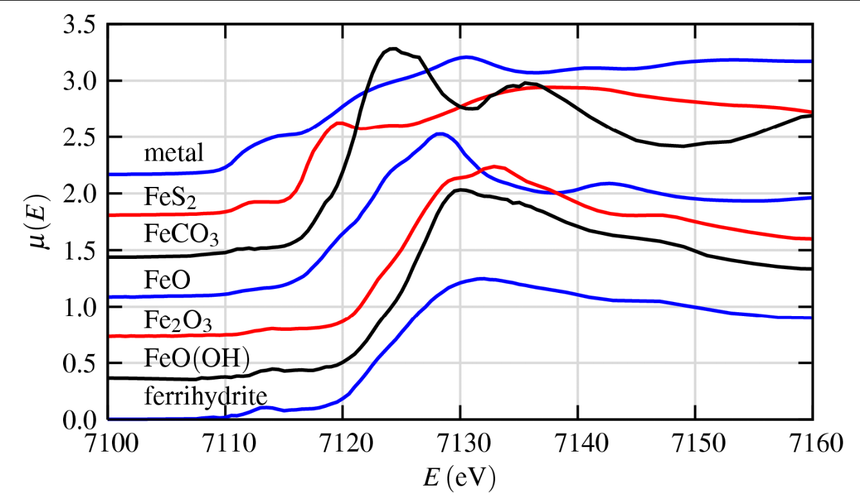
Edge position: oxidation state
XANES can be used simply as a fingerprint of phases and oxidation state.
XANES Analysis can be as simple as making linear combinations of “known” spectra to get compositional fraction of these components.
Page 36

Slide 37
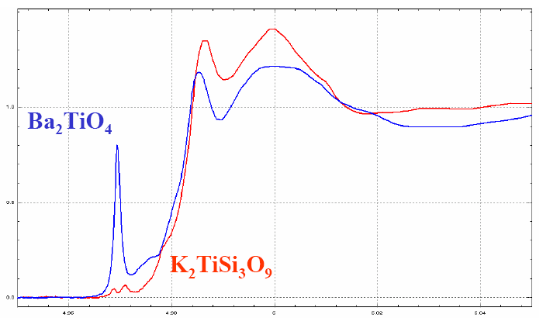
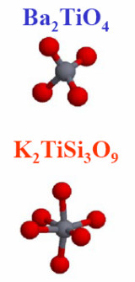
Xanes analysis: local coordination enviroment
Both Ti⁴⁺
Pre-edge feature
1s → 3d
Ti K-edge XANES is highly dependent on the local coordination:
(1) Tetrahedral vs. Octahedral
(2) Different neighbors shells beyond the first O-shell
Page 37

Slide 38


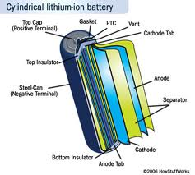

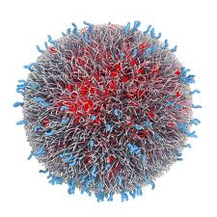

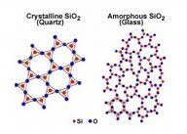
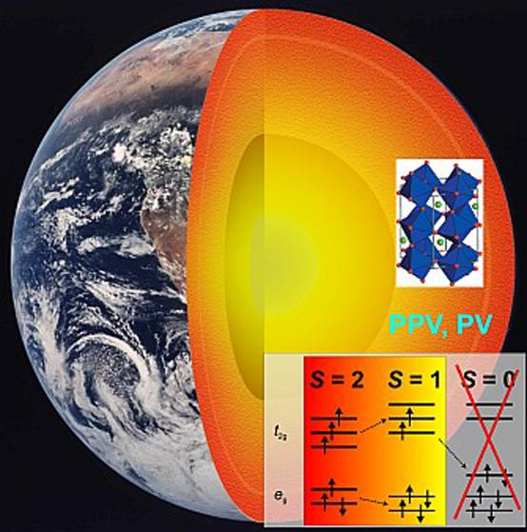

What can XAS be measured on?
... just about almost anything and with most elements of the periodic table
Art: Cultural Heritage
?
No assumption of symmetry or
periodicity
Biology
Material Science
Local probe!
Physics
Enviromental
Science
Geology
Chemistry
Catalysis

Slide 39
XAFS applications
Catalysis
Chemistry
Material Science (High Tc, CMR, ...)
Magnetic materials ← XMCD
Amorphous and Liquid systems
Thin films and surface science
Biological materials
Environmental science
Challenge of XAFS
Time-resolved XAFS
Micro- or Nano-XAFS
DAFS (Diffraction anomalous Fine Structure)

Slide 40
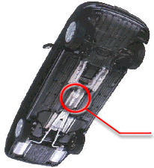
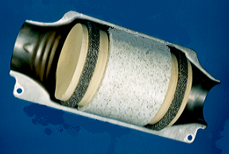
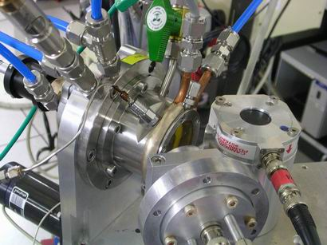
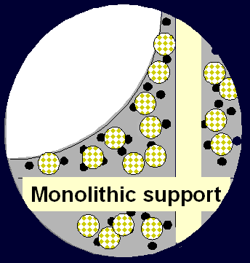
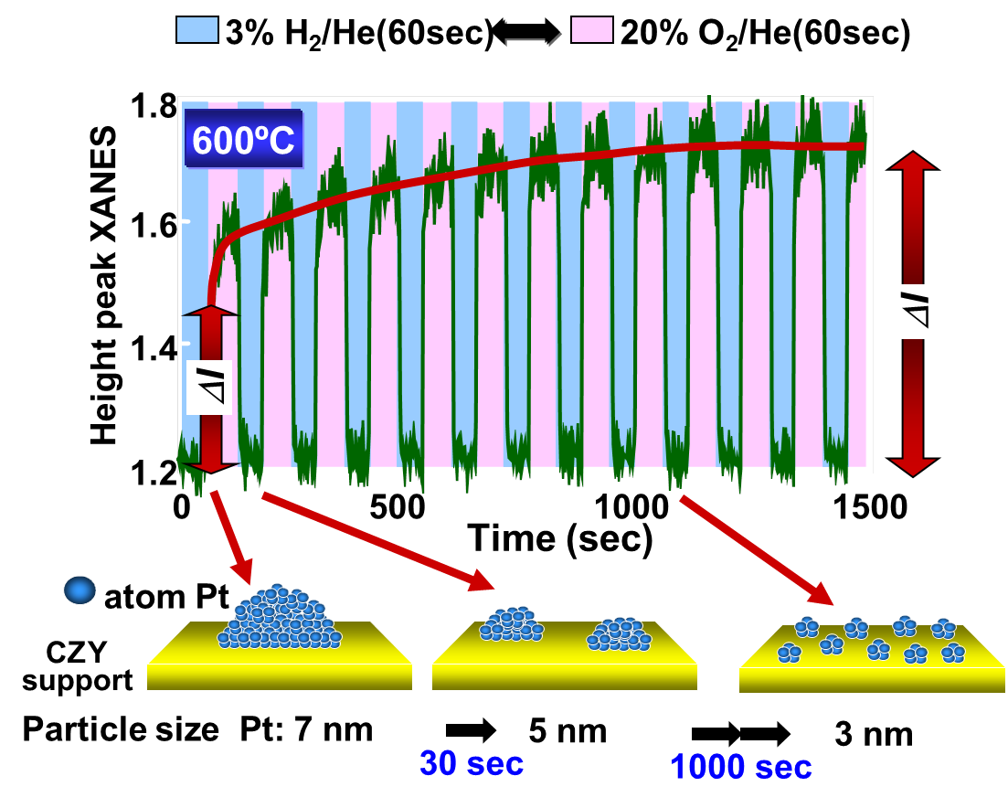
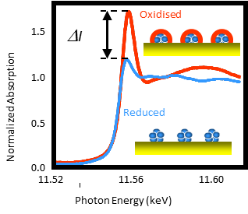
Applications: catalysis
Controls 80 % world´s chemical manufacturing processes
Reproduce real catalytic reaction conditions (car´s exhaust pipe) to develop new catalytic converters
Reproduce T and mixture of gases for real driving conditions
NOx
CO
HC
N₂
X rays
H₂O
Three-way-catalysts
CO₂
Pt
Active site : Pt, Rh, Pd
Support : alumina, etc.
Additives : CeO₂, CeO₂-ZrO_{2,} alkaline etc.
Ceramic support
Dynamic and in situ study via X ray Absorption in Fluorescence
Experiment performed by TOYOTA.

Slide 41
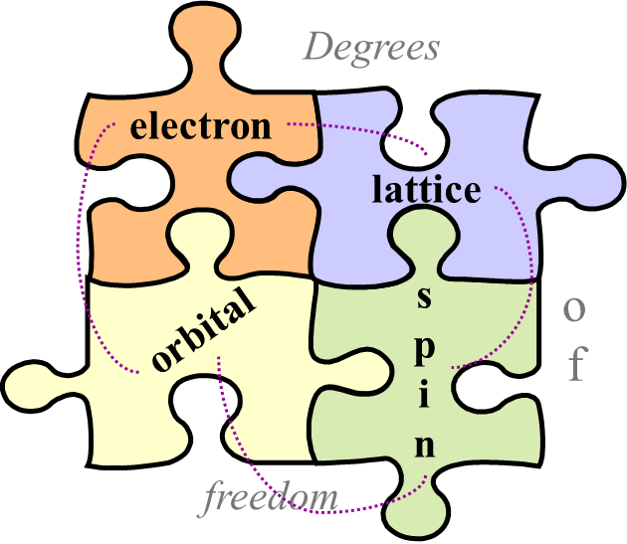
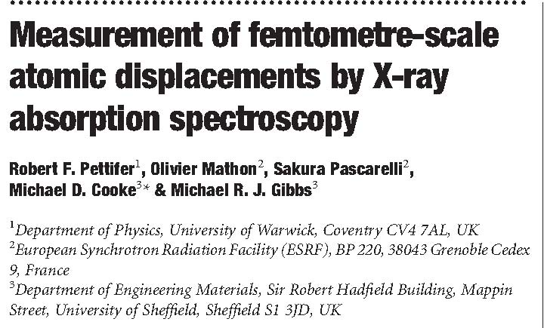
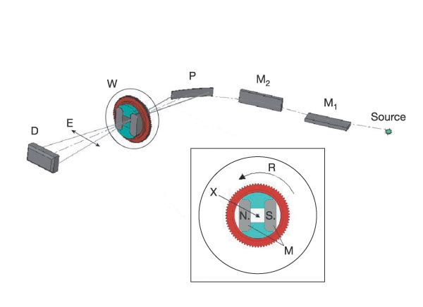
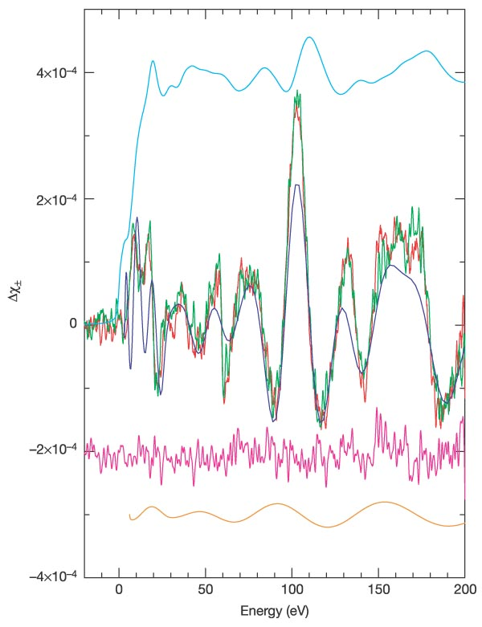
Applications: solid state physics
Structural changes due to phase transitions
Temperature
Pressure
Magnetic Fields,…
Fe-Co thin films. Periodic strain through magnetostriction.
Magnetostriction can be detected with EXAFS (diff) !
Normal exafs accuracy 0.01- 0.001 Å
Q-exafs→Diff-exafs sensitivity of 1 fm (0.0001 Å)

Slide 42
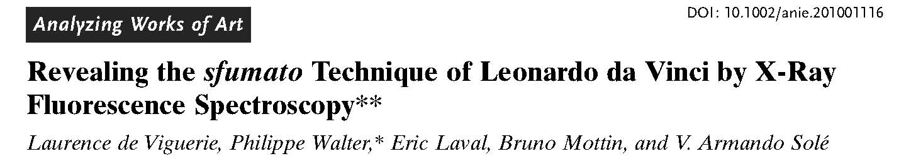
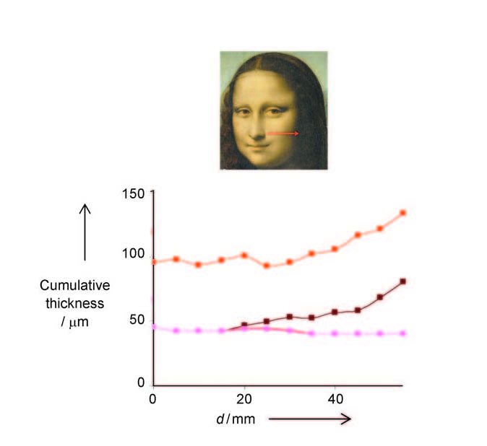
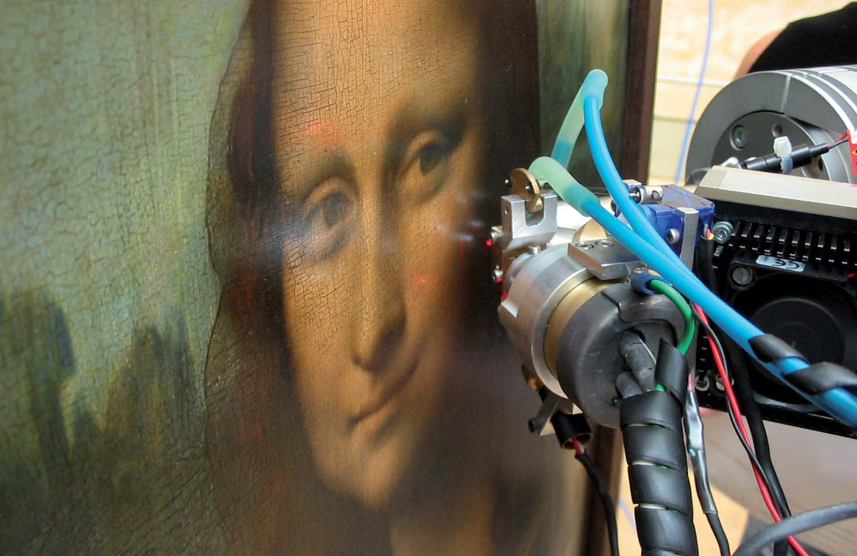
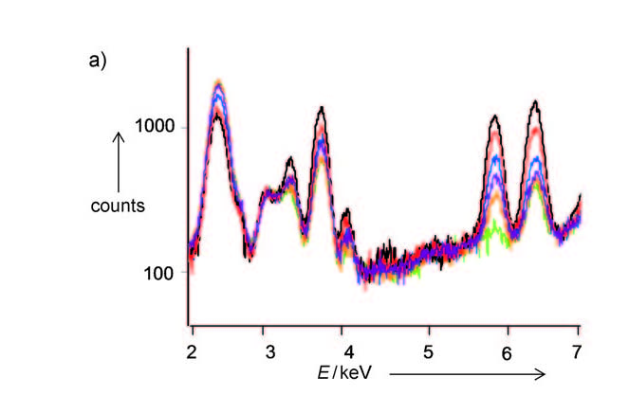
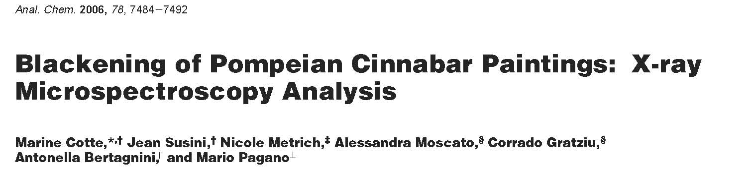
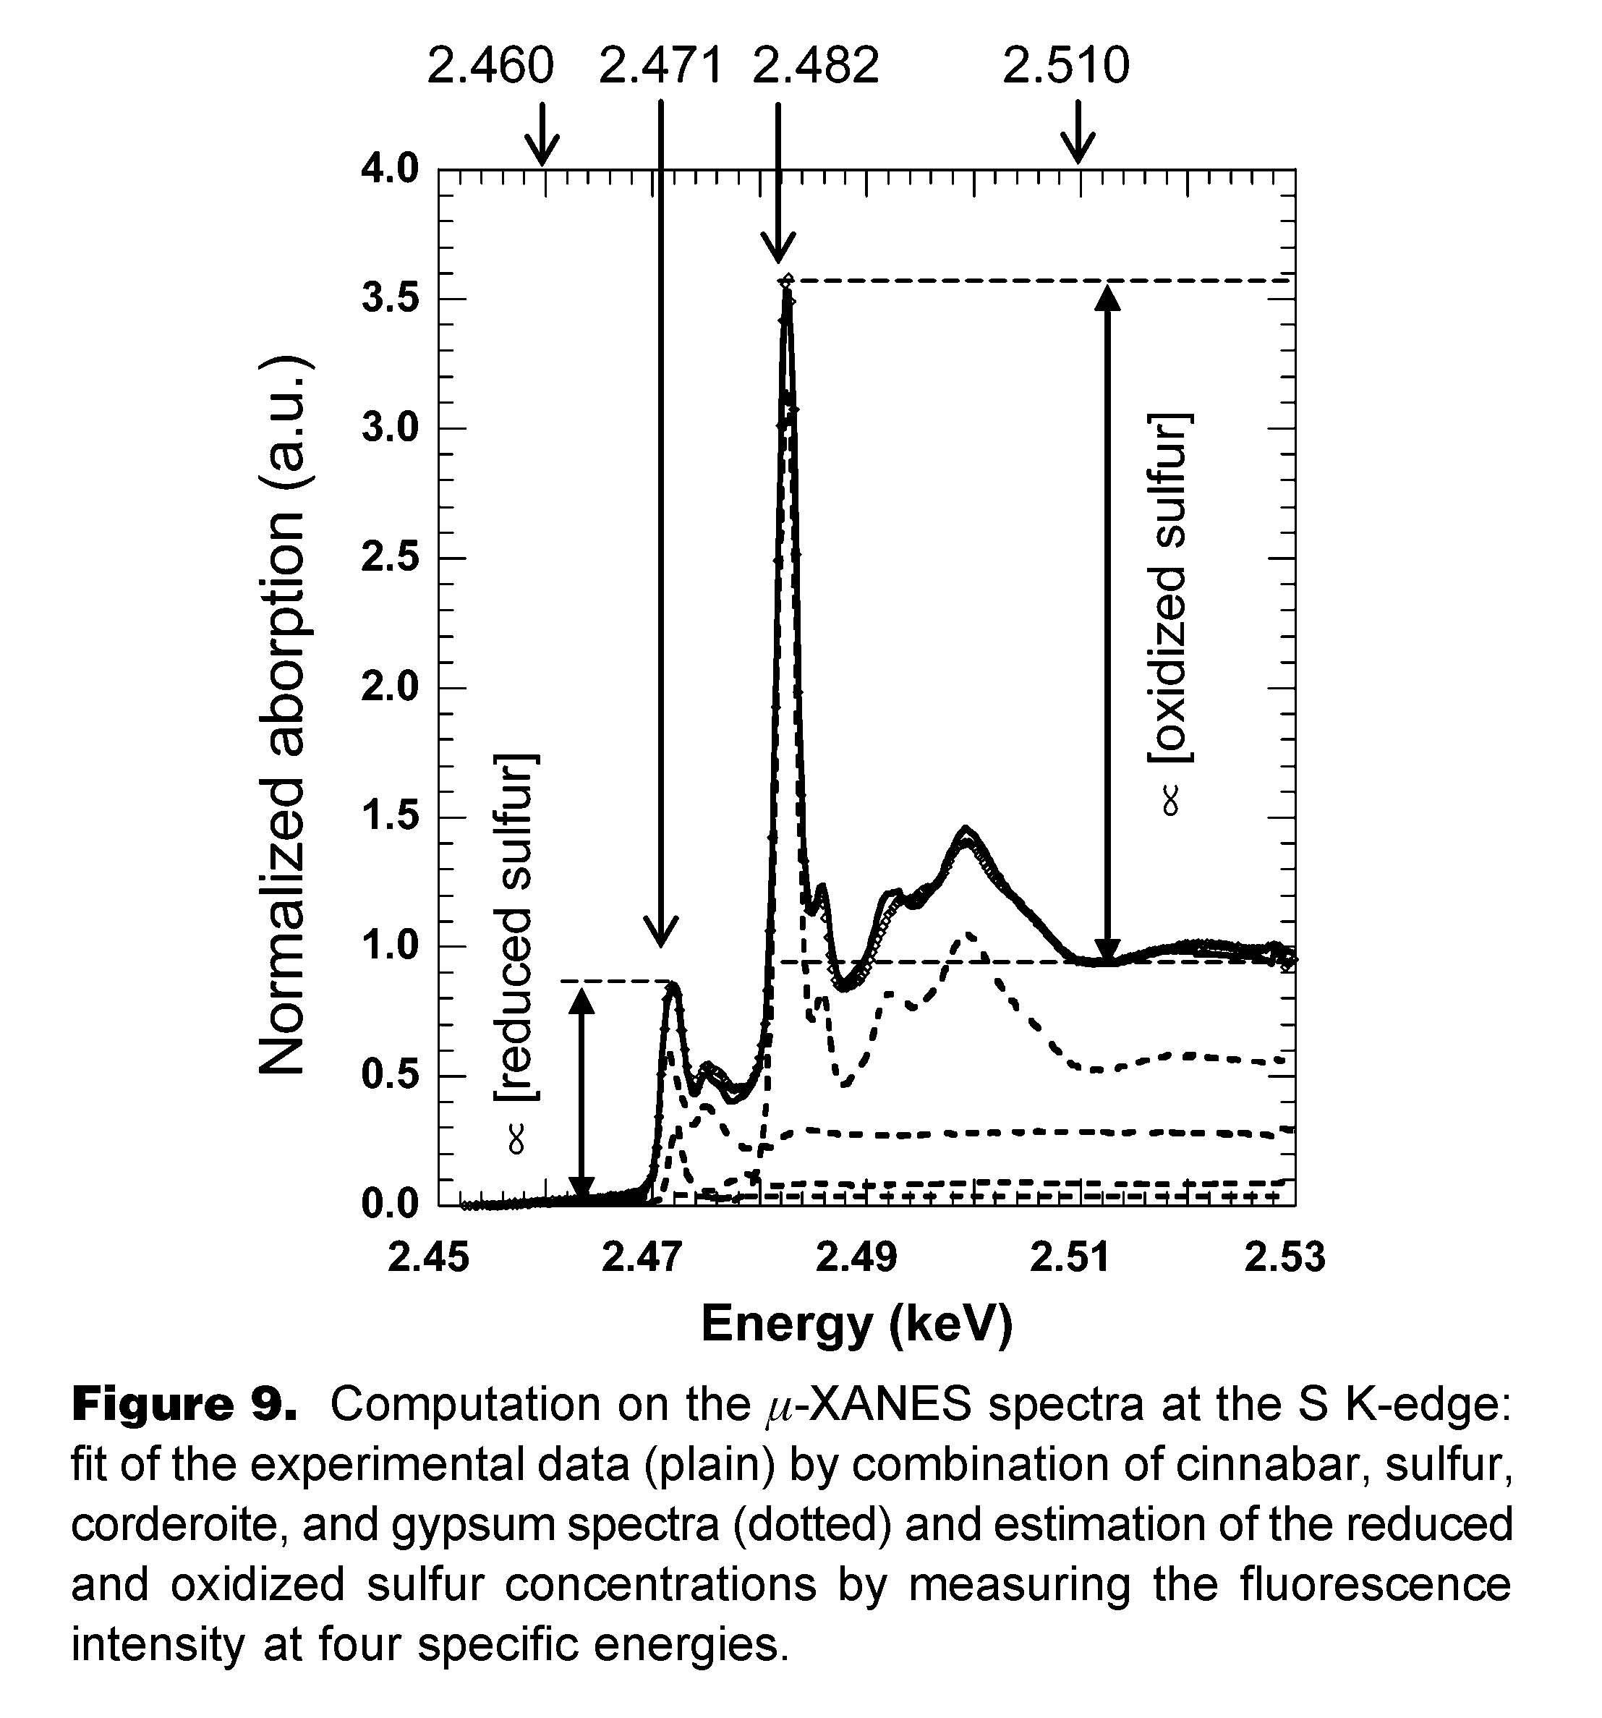
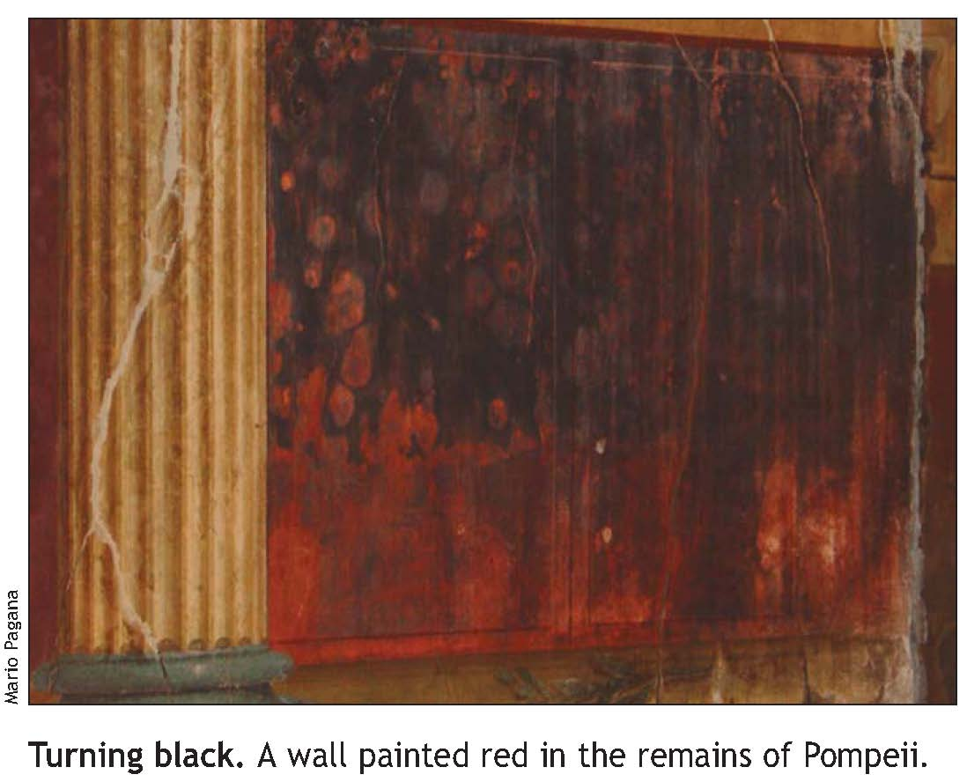
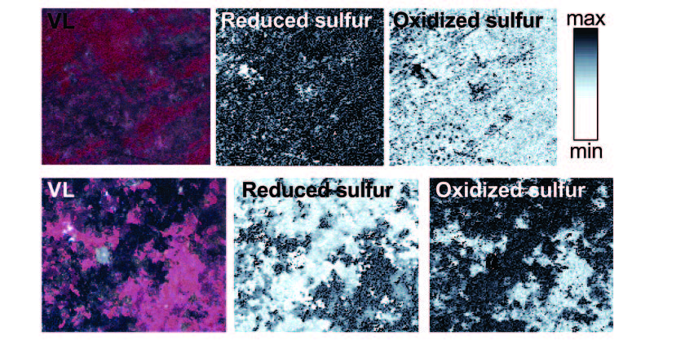
Applications: cultural heritage
Non-invasive
Binder Concentration
Pigments Inorganic composition
Layers Thickness
Mn, Fe pigments on the glaze
Pb in every layer
Glaze layers unfinished
Why do the red walls of Pompei go black?
Reaction of chlorine with cinnabar leads to the formation of gray chlorinemercury compounds.
The sulfation of calcite results in the development of black coatings on the painting surface.

Slide 43


Take-home message
Exafs is sensitive to …
Local structure in non-crystalline matter
Local environment of an atomic impurity in a matrix of different atomic species
Study of systems whose local properties differ from the average properties
Detection of very small distortions of local structure
Density of
electronic states

Slide 44
WHERE TO GO FROM HERE
Books and Review Articles:
Basic Principles and Applications of EXAFS
Handbook of Synchrotron Radiation, Chapter 10, pp. 995-1014, E. A. Stern and S. M. Heald,
E. E. Koch, ed., North-Holland 1983
X-ray Absorption: Principles, Applications, Techniques of EXAFS, SEXAFS and XANES
in Chemical Analysis Vol. 92, D. C. Koningsberger and R. Prins, ed., John Wiley & sons, 1988
X-ray Absorption Fine Structure for Catalysis and Surfaces
World Scientific Series on Synchrotron Radiation Techniques and Applications Vol. 2, ed., Y. Iwasawa, 1996
X-ray absorption spectroscopy in coordination chemistry
J. E. Penner-Hahn, Coordination Chemistry Reviews 190-192, pp. 1101-1123, 1999
Tutorials and other Training Material:
http://xafs.org/Tutorials
http://gbxafs.iit.edu/training/tutorials.html Grant Bunker’s tutorials
http://srs.dl.ac.uk/XRS/courses/ tutorial from Daresbury Lab, UK
Software resources:
http://xafs.org/Software
Analysis programs: Atoms + Feff + iFeffit (Theoretical XAFS calculations and fitting) – Univ. Chicago (USA)
Athena, Artemis (EXAFS Data Reduction and fitting
http://gnxas.unicam.it : Gnxas (Theoretical XAFS calculations and fitting) – Univ. Camerino (Italy)
http://www.esrf.fr/computing/scientific/xop/ XOP (DABAX data base, cross-section and lots of general x-ray
Calculations, multipurpose data visualization and analysis)-M. Sanchez del Rio, and R. J. Dejus (ESRF, France)
http://srs.dl.ac.uk/XRS/index.html : Excurv98 (Theoretical XAFS calculations and fitting) – Daresbury Lab (UK)

Slide 45
DATA PROCESSING AND ANALYSIS
Iffefit package:
http://cars9.uchicago.edu/ifeffit/
http://bruceravel.github.io/demeter/
Athena: data processing
Artemis: data analysis using Feff

Slide 46
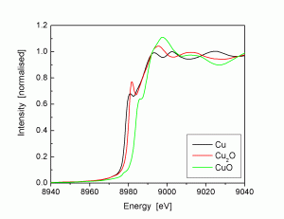
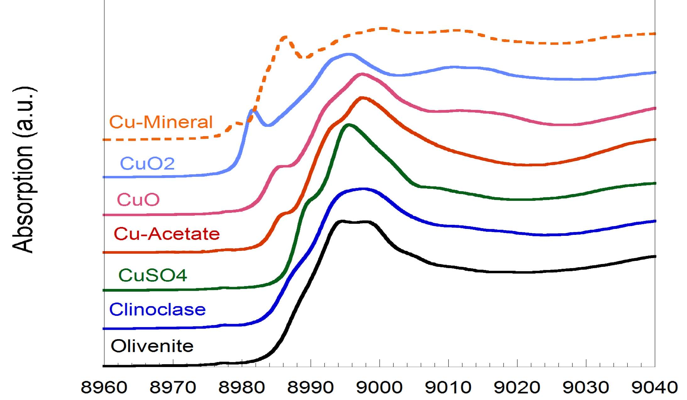
Cu foil and cuo analysis: xanes
Cu foil Cu⁰, 3d¹⁰ 4s¹
Cu₂O Cu¹⁺, 3d⁹ 4s¹ Cu Tetrah.
CuO Cu²⁺, 3d⁸ 4s¹ Cu square planar

Slide 47
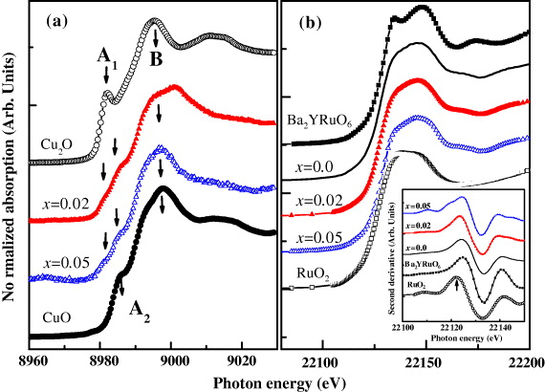
Cu metal and cu oxide xafs
Cu foil Cu⁰, 3d¹⁰ 4s¹
Cu₂O Cu¹⁺, 3d⁹ 4s¹ Cu Tetrah.
CuO Cu²⁺, 3d⁸ 4s¹ Cu square planar
The pre-edge features marked A₁ and A₂, respectively, in the Cu₂O and CuO spectra represent transitions from the 1s → axial 4p state, which contain a small portion of the unoccupied 3d states as the quadruple allowed transitions and are close to the 4s state. The feature marked as B is mainly due to the transition from copper 1s to the 4p state

Slide 48
Cu foil analysis
Data processed, with Athena.
Crystal structure (or reference crystal structure) known.
Cu metal, FCC, Fm-3m
CuO, monoclinic, C2/c
Inorganic Crystal Structure data base
https://icsd.fiz-karlsruhe.de/search/basic.xhtml;jsessionid=5DC14101FB0549F273F08BC77D85DF9D
Create the cluster, with ATOMS.
Create the scattering paths, with FEFF (integrated in Atoms)
1st shell analysis, with ARTEMIS.

Slide 49

Cu foil analysis: Atoms
Create the cluster
Atoms page > Click Run Atoms
Make input (feff.inp) for theoretical calculation (FEFF)
Structural info
Absorption edge
Atom with core hole

Slide 50

Cu foil analysis: Atoms
Create the cluster
Atoms page > Click Run Atoms
Structural info
Absorption edge
Atom with core hole
Make input (feff.inp) for theoretical calculation (FEFF)

Slide 51

Cu foil analysis: Atoms
Create the cluster
Theory input page feff.inp > Click Run Feff
Absorption lenghts
Normalization correction
Crystallographic Info
Hole number
and S02 value
Atomic potential index list

Slide 52

Cu foil analysis: atoms
Theory input page > Click Save File (feff_Cufoil.inp)
Absorption lenghts
Normalization correction
Hole number
and S02 value
Atomic potential index list

Slide 53

Cu foil analysis: atoms feff page
Theory input page (Feff) > Click Run Feff
Atomic potential index list
Index value
for atomic
potentials
List of atomic positions

Slide 54

Cu foil analysis: artemis
Select FEFF calculation
to display this page

Slide 55

Cu foil analysis: artemis
Feff paths
Deg: Degeneracy of the path (number of identical scattering paths)
Reff: Inital half path length (bond length for single scattering path)
amp: Estimate of amplitude of path relative to first path.
• fs: Number of forward scattering events.
• Scattering Path: atoms scattering photoelectron, [+] symbol represents core atom.

Slide 56

Cu foil analysis: artemis
Path description
Fitting parameters

Slide 57

Cuo xtal structure

